Slide 1
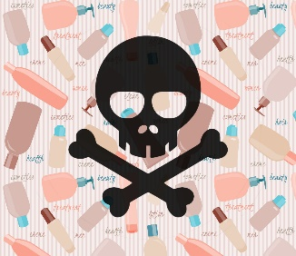
Chemical Cosmetic Analysis Power BI Dashboard Presentation
Pegah Chavoshi Chamani
August 2023

Slide 2

Introduction
Data Study on Harmful Chemicals in Cosmetics
Cosmetics usage is increasing globally, including among men and children.
Concerns arise due to the vast product range and complex ingredients in cosmetics.
This data study utilizes The California Safe Cosmetics Program data to provide visualizations for informed consumer decisions.

Slide 3
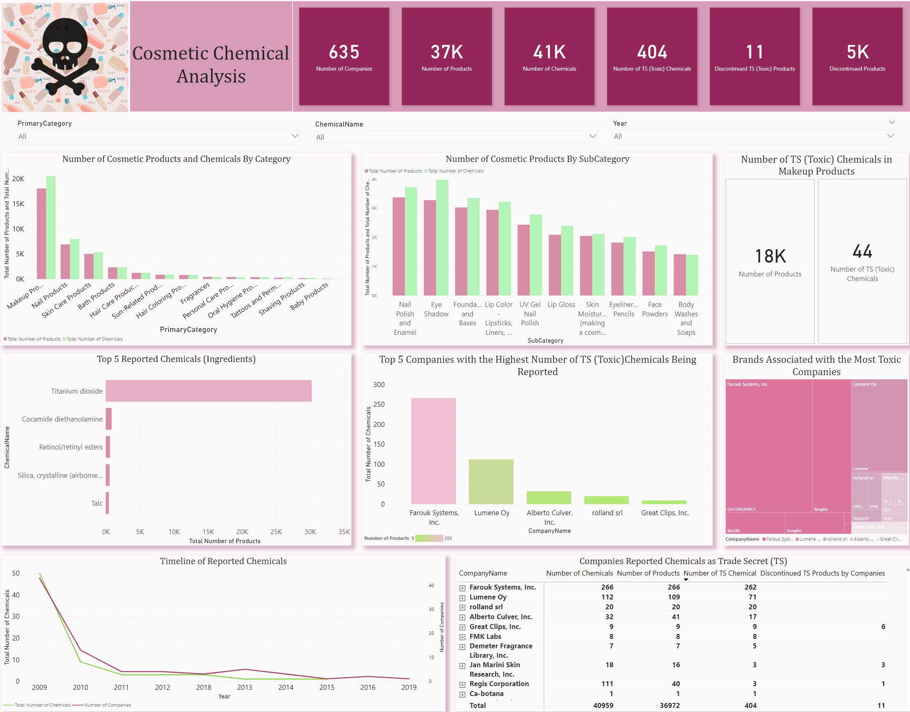

Slide 4
Background
Cosmetic product use is rising worldwide.
Cosmetics market experiencing significant product diversity.
Increasing concerns about the complex makeup of cosmetic ingredients.
Elevating consumer awareness about the potential health impacts of specific cosmetic components.
Encouraging consumers to identify companies and brands with elevated levels of harmful chemicals in their products.

Slide 5
Problem
Chemicals' Health Impact: Harmful chemicals in cosmetics can pose significant health risks to consumers.
Regulatory Response: To address these concerns, the California Safe Cosmetics Act mandates companies to disclose ingredients known or suspected to cause cancer.
Consumer Protection: Lack of proper reporting and transparency could result in consumers using products containing harmful chemicals without their knowledge, thus endangering their health.

Slide 6
Challenge and Solutions
The lack of awareness about harmful ingredients in cosmetics
Analyzing the reported data to identify trends and raise awareness.

Slide 7
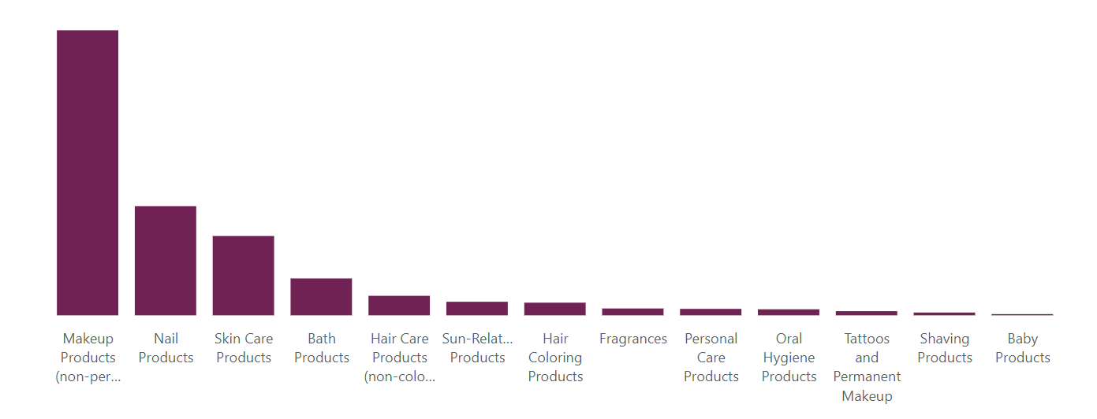
The Most Reported Product
Non-Permanent Makeup category has the highest count of reported products, indicating that these products contain a significant number of potentially harmful chemicals.
Baby category has the lowest count of reported products, suggesting that cosmetics targeted for infants and children are relatively safer in terms of reported harmful chemicals.

Slide 8
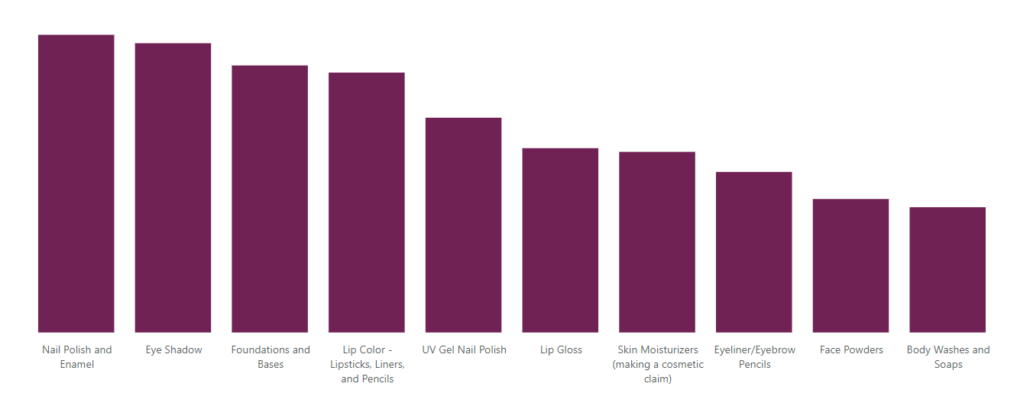
The Most Reported Subcategories
The sub-categories that have the most reported products within the Non-Permanent Makeup category are Eye Shadow, Foundations and Lipsticks.
This data provides insights into which specific types of makeup products are more likely to contain harmful chemicals, enabling consumers to be cautious while selecting these products.

Slide 9
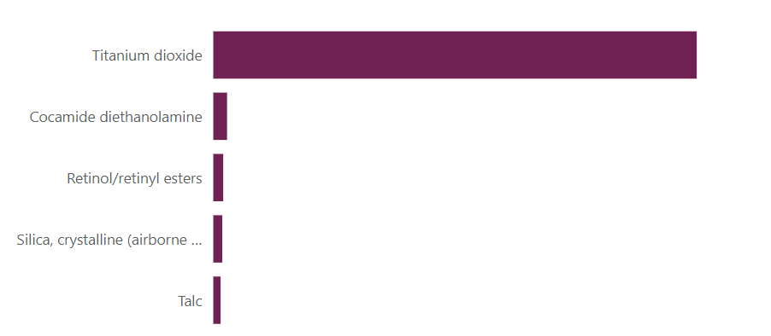
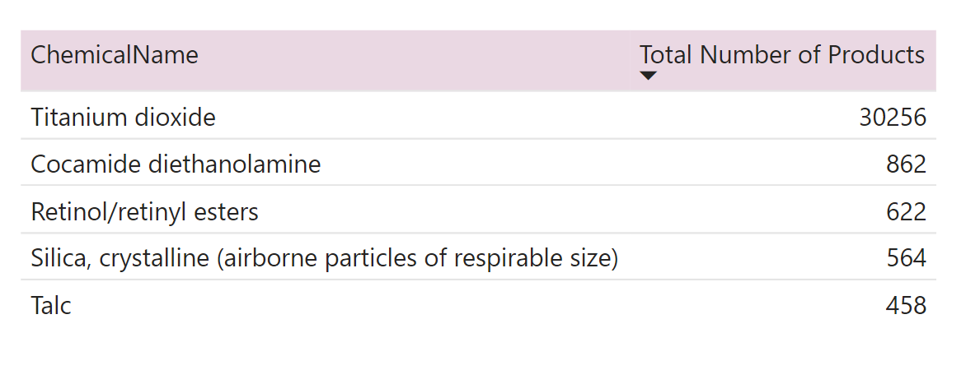
Top 5 Chemicals
Analysis - Top Five Chemicals in Each Category:
Titanium Dioxide is the most used chemical in almost all categories.
Titanium Dioxide, a UV protector, is classified as a possible carcinogen when inhaled.
Cocamide Diethanolamine and Retinol/Retinyl Esters, Silica, and Talc appear in multiple categories.
Notes:
Titanium Dioxide is used to protect against UV rays but could be a cancer risk if inhaled.
Titanium Dioxide is often used in cosmetics as a protection against UV radiation, has the potential to cause cancer when it is inhaled into the body.

Slide 10
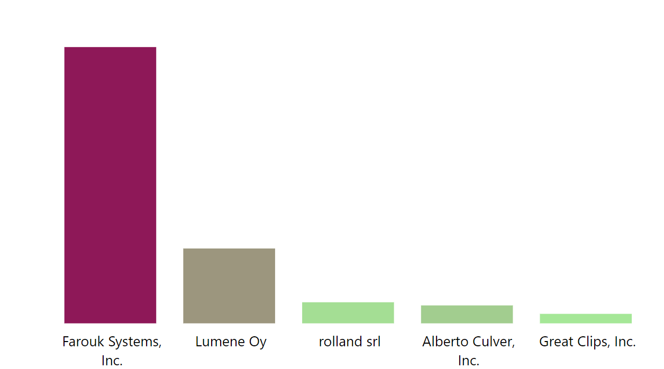
Companies
Analysis - Top Five Companies with Toxic Chemicals:
Farouk Systems, Inc. has the most toxic ingredients
These toxic ingredients are predominantly found in their hair coloring products.

Slide 11
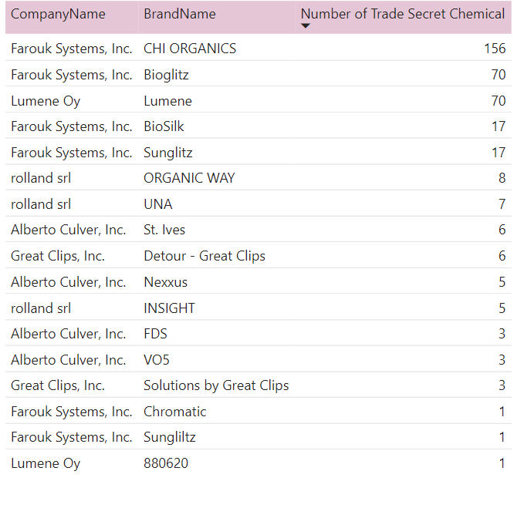
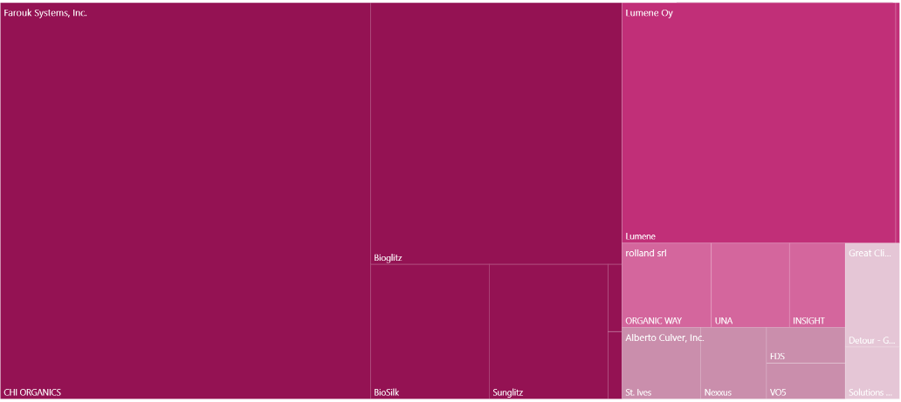
Brands
Analysis – Brands associated with:
Chi Organics has the most toxic ingredients in their hair coloring products

Slide 12
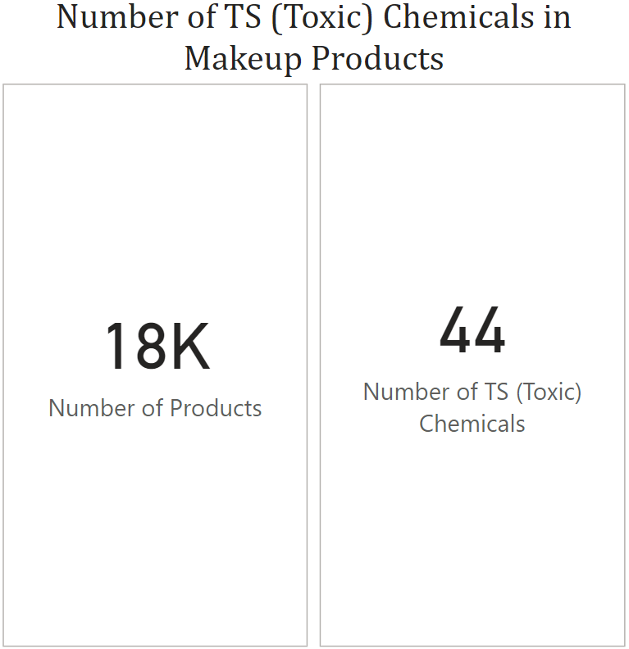
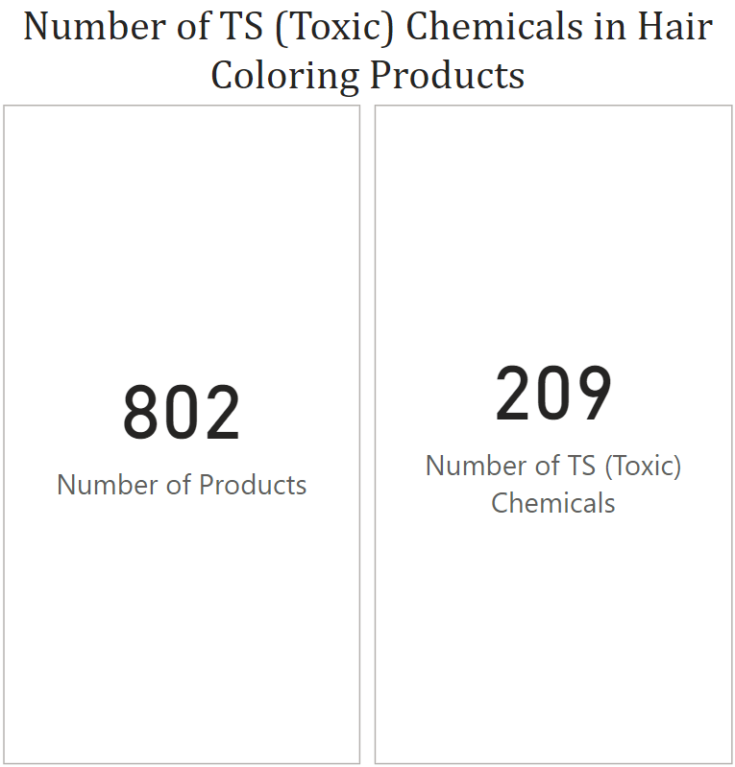
Toxic Chemical Comparison

Slide 13
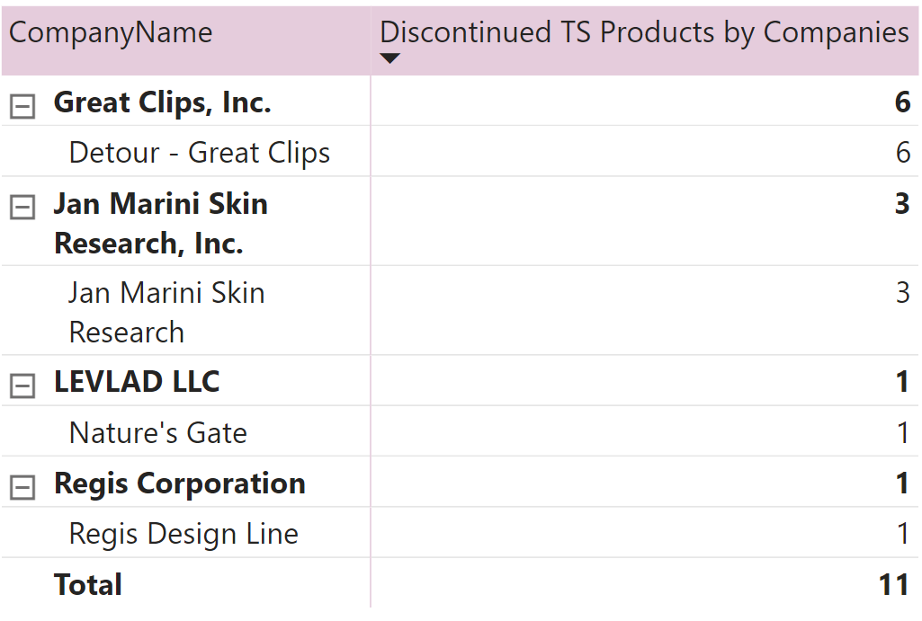
Discontinued Toxic Chemicals
Great Clips, Inc.: Hair Products
Jan Marini: Skincare Products
Nature’s Gate: Makeup and Hair Products
Regis Design Line: Hair and Skin Products

Slide 14
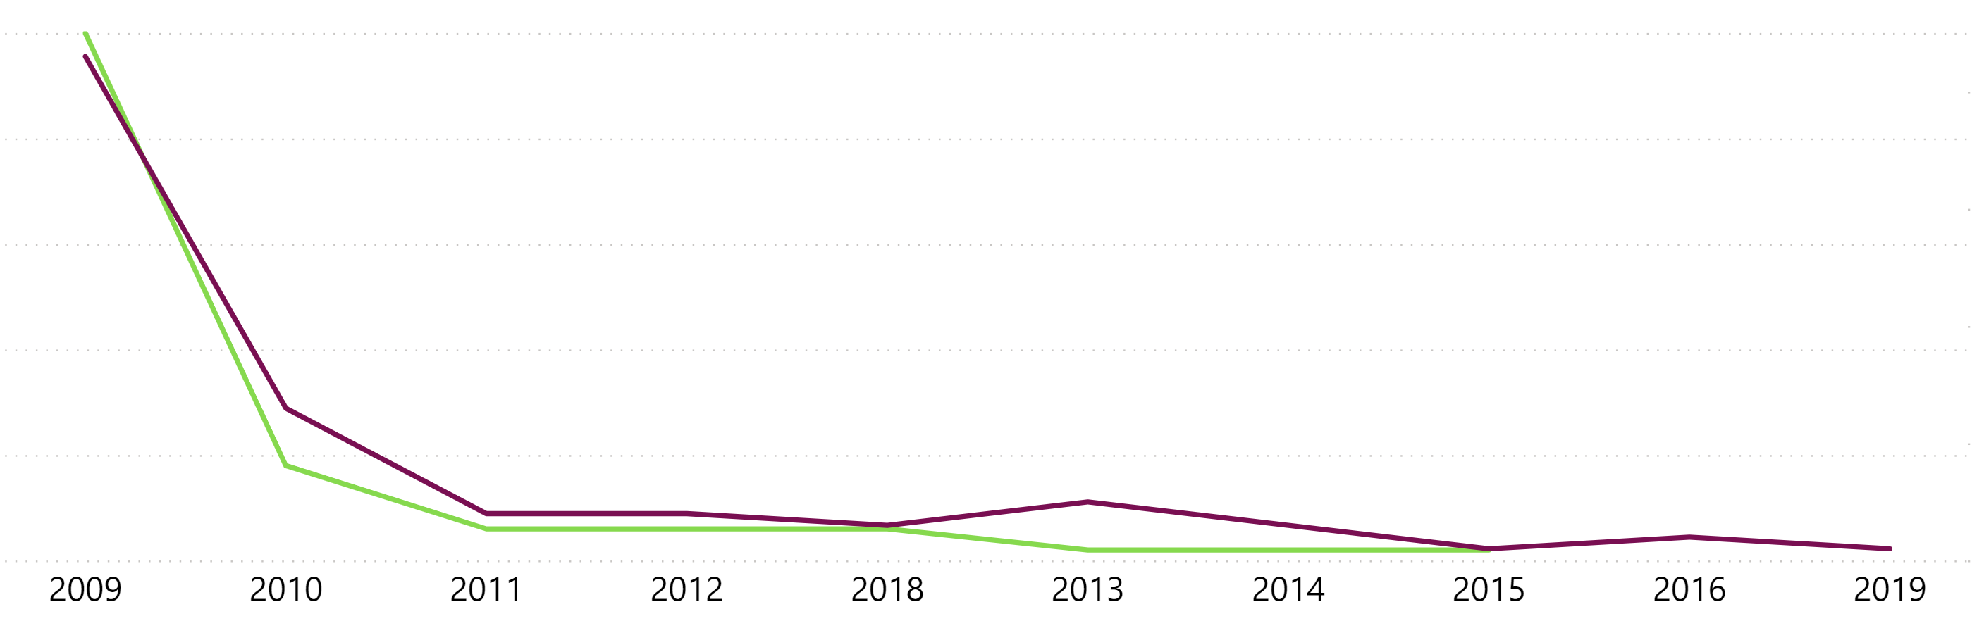
Timeline of Reported Chemicals

Slide 15
Summary
Key Findings
Reported cosmetic products in 13 categories contain potentially harmful ingredients.
Makeup accounted for the majority of reported products (48%).
The most commonly reported chemical is titanium dioxide, often found in pigmented products.
Farouk Systems, Inc. is found to have the highest presence of toxic ingredients, primarily in their hair coloring products.
A total of 11 toxic chemicals are currently being reported as discontinued in cosmetic products.

Slide 16
Thank You
Pegah Chavoshi Chamani
Pegah.Chavoshi@gmail.com
https://www.linkedin.com/in/pegah-chavoshi-chamani/

